Slide 1
The Startup
How We Came To Be

Slide 2
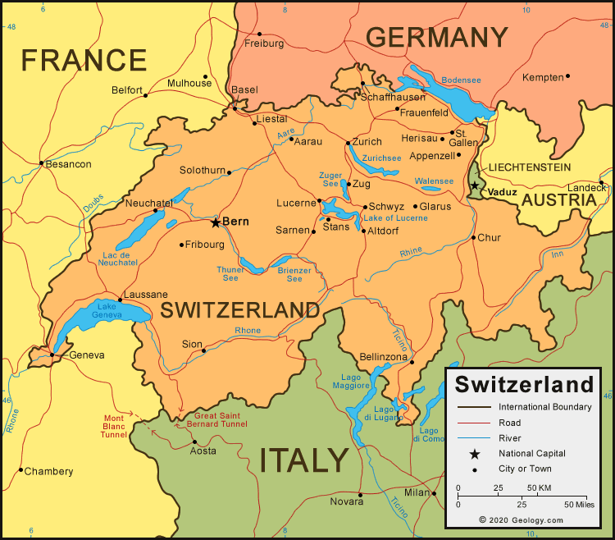
Four People
Very Different Profiles
1 Boomer, 3 GenX
1 married, 1 Konkubinat, 2 Single
1 football, 1 boardgames, 2 videogames
3 with glasses, 1 not yet
Could not coop with each other, had different Swiss experiences…

Slide 3
With a Common Purpose
Work for a Better Future
Join the PowerCoders opportunity at the same time
Brought their unique and diverse experiences: (links)
Denys – Team Spirit
Oana – Speaking in Public
Ivan – Experience in IT
Anastasiia – Resilience

Slide 4
Structuring a Learning Path
Learn to structure and display content with HTML
Learn to add attractive format to the content with CSS
Learn to add useful behaviour with JS
Thirst for learning and fostering the ability to overcome challenges

Slide 5
(We go through) Experimenting
Show some samples of practical learning (websites, code…)
(Assume here there are graphics/images and links.)

Slide 6
(Now We Do) Amazing Projects
Display (for instance) the personal projects / any other cool thing we think we can do.
(Assume here there are graphics/images and links.)

Slide 7
Ready to Break New Boundaries
Display the Techs we know,
The Skills we have,
The Fields we love
To make better things happen.
(And this is where the ‘presentation part’ ends and links to the company’s homepage, where the actual services would be presented.)

